Slide 1
ECE 550 Final project Tetris Game
Group Members:
HAOCHI BAI
Hao Chen

Slide 2
Accomplishment
Baseline:
I/O
Falling Pieces of Different Shapes
Clear/Manage Lines
Rotation
Scores
Add-ons:
Interrupts
Speed Power-Up

Slide 3
I/O
Our game uses PS2 keyboard to control block movement
Keyboard “W” controls block ROTATION
Keyboard “A” controls LEFT movement
Keyboard “D” controls RIGHT movement

Slide 4
Falling Pieces of Different Shapes
Our game has 5 shapes with 4 squares each
I-Type
T-Type
O-Type
J-Type
L-Type

Slide 5
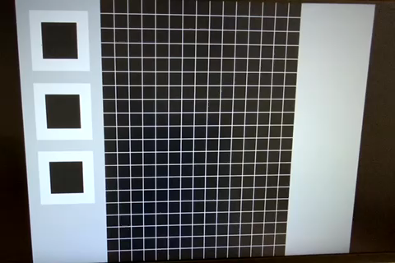
Falling Pieces of Different Shapes

Slide 6
Clear/Manage Lines
Clear Line
Our game will check whether exists a whole line in D MEM from the BOTTON to the TOP of screen.
If a filled line is detected, these lines will be cleared and squares on higher lines can drop.
Collision detection
Our game will predict Block movement in the next frame according to keyboard input (LEFT,RIGHT,ROTATE).
If exist block overlap, current block will just stay there. Otherwise, keep moving.

Slide 7
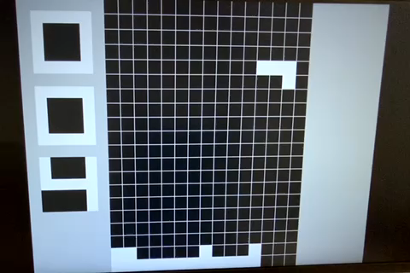
Clear/Manage Lines

Slide 8
ROTATION
The player can rotate the shapes in 90 degrees granularity.
Check squares nearby to see if it can be rotated
If OK, load a new block from DMEM into the reg

Slide 9
Scores
Our game can show the user a score.
When a line is cleared, update the score
Score is stored in a register
The score register is connected to the VGA and shown on the screen.

Slide 10
Interrupts
The player can use the processor to interrupt the game.
When “P” is pressed, the program comes into an infinite loop
In the loop, when “C” is pressed, the program backs to the normal state.
“R” is to reset the game, which clears the DMEM and restart the game

Slide 11
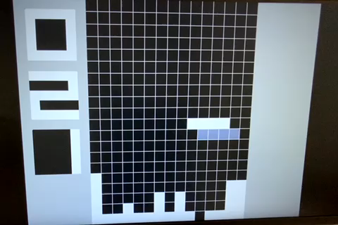
Interrupts

Slide 12
Speed power-up
Our game can automatically increase the falling speed.
When the score is increased, reduce the maximum waiting time of refreshing the screen in the processor (D MEM).

